Slide 1
Contact Manager Group 17
Notes:
Contact manager
Register with full name, username, and password
Log in with a username and password
Individualized contacts for each user
Contacts consist of first, last name, and email
Edit and delete from main contact page

Slide 2
Team Members and Roles
Project Manager: Matthew Eisenberg
Frontend
Backend
Database
William Barrett
Jia Jones
Dennis Gorman
Ahmed Salama
Pedro Criado

Slide 3








Technology Used
Frontend
Backend
Database
Notes:
General purpose
GitHub: file tracking and collaborating
Trello: task scheduling
MobaXterm: easy server deployment
Discord: general communication and voice calls
PHP Storm and Visual Studio Code: collaborative code editing
Collaborative coding allowed us to work on the same files at the same time
Front-end
Figma: page designs
Back-end
SwaggerHub: API documentation and specifications
Allowed for quick testing of API and responses with sample data
Database
MariaDB/SQL: database structure
Required for working with database

Slide 4
What went well
Were in constant communication
Once a design was decided, the process of creating it came easily
Database was set up quickly

Slide 5
What did not go well
Lack of experience delayed the development process
Took some time to come to a consensus on what to include in the design and the website functionality
Had difficulty coding and testing when everyone was making changes concurrently

Slide 6
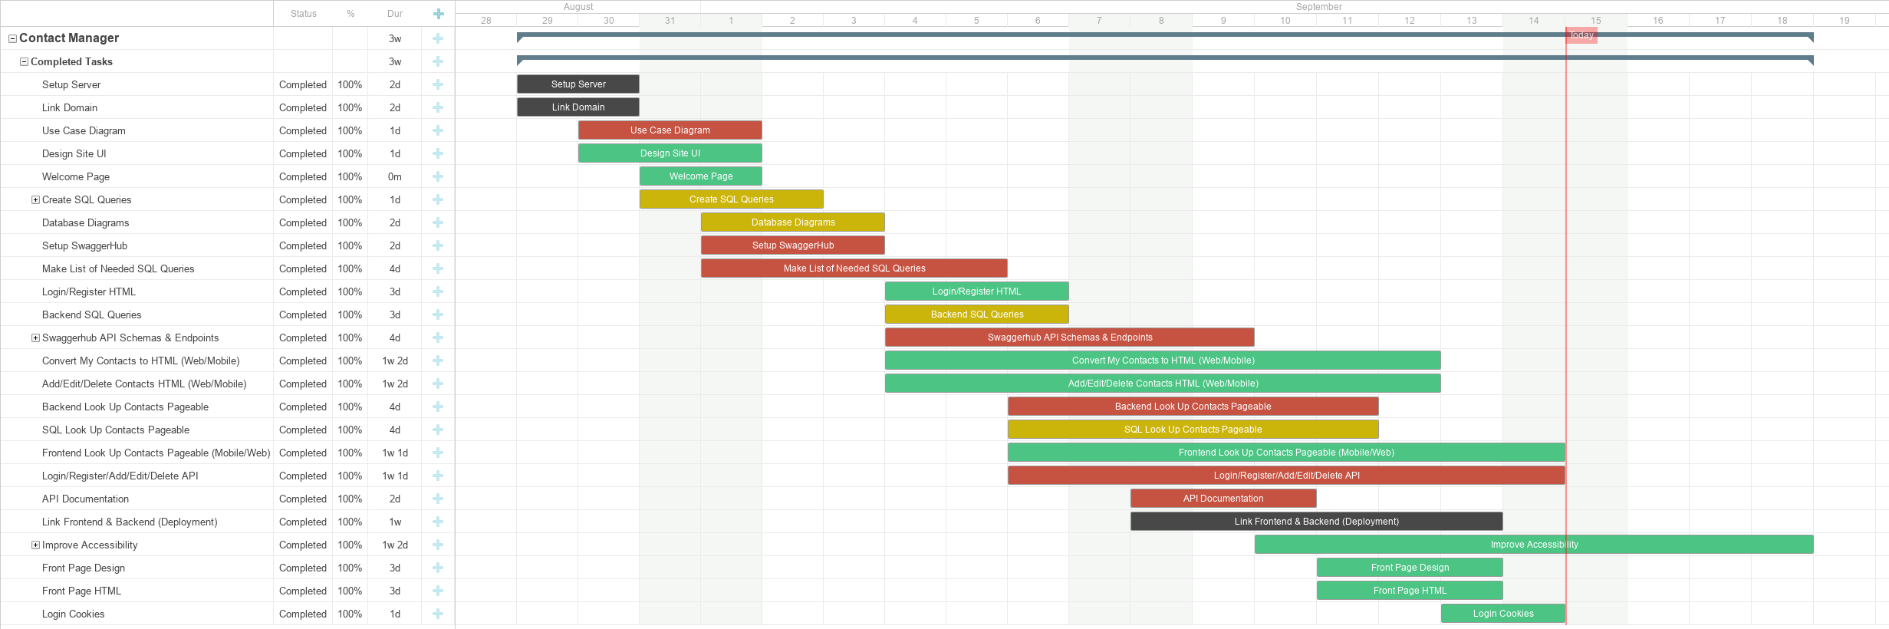
Gantt Chart

Slide 7
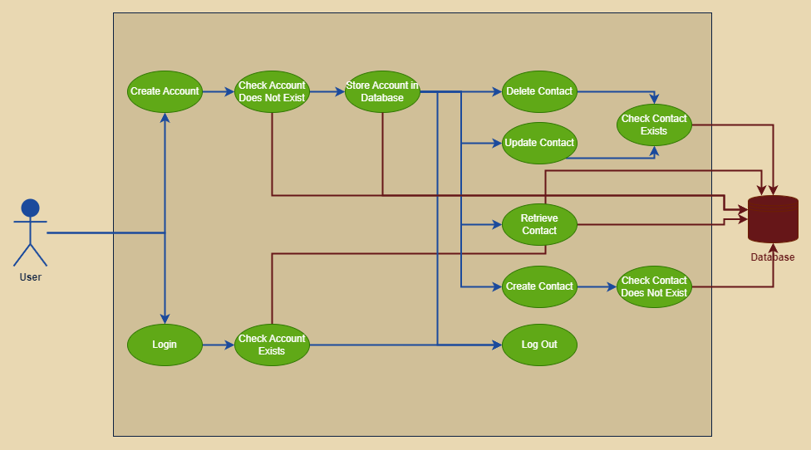
Use Case Diagram

Slide 8
Entity Relation Diagram
Logins
ID | Int
FirstName | VarChar
LastName | VarChar
UserName | VarChar
Password | VarChar
Contacts
ID | Int
UserID | Int
FirstName | VarChar
LastName | VarChar
Email | VarChar

Slide 9
SwaggerHub and Website Demo

